Slide 1
Asynchronous Mod 5 Counter
CET1044B
S.Y.B.Tech
A.Y. : 2022_23
Semester : III
DECA CCA Component II
Group Presentation on Design

Slide 2

Group Members
PA-16 Shivranjan Yogesh Pathak { PRN : 1032210860 }
PA-17 Pratyush Chowdhury { PRN : 1032210864 }
PA-18 Avipsa Ghorai { PRN : 1032210867 }
PA-19 Vaishnavi Anand Powar { PRN : 1032210874 }
PA-20 Krishnaraj Prashant Thadesar { PRN : 1032210888 }

Slide 3
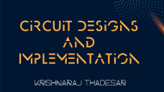


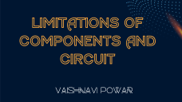

Contents

Slide 4
Introduction & Insights
Avipsa Ghorai

Slide 5
Problem Statement
A 4D movie Theater has a capacity of 5 seats.
Design a digital system to be installed at entry of the theater for counting the entrants.
Give the indication when the theater is full. Comment on the advantages and limitations of the circuit designed.
Mention any other solution available for the same problem.

Slide 6

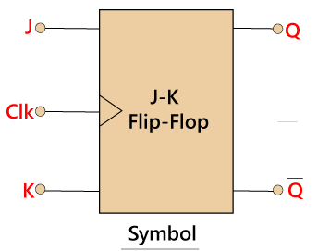
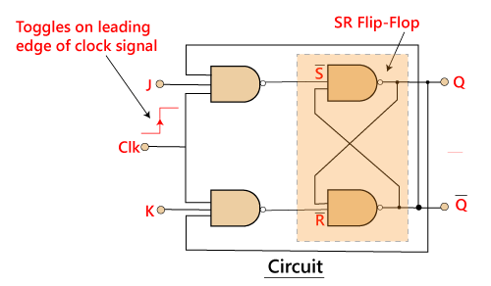
Flip Flops
A flip-flop is a binary storage device having two stable states —HIGH or 1, and LOW or 0.
A flip-flop has the property of maintaining the same state until and unless an input signal tells it to switch its state.
Flip-flops are the fundamental building blocks of the digital system. In the sequential logical circuit, the flip-flop is the basic storage element.

Slide 7
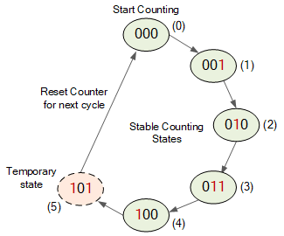
Counters
A special type of sequential circuit used to count the pulse is known as a counter.
It is a collection of flip flops where the clock signal is applied.
The counter is one of the widest applications of the flip flop.
Based on the clock pulse, the output of the counter contains a predefined state.
Mod-5 Count Sequence

Slide 8
Asynchronous Counters
The number of flip flops used in an asynchronous counter depends upon the number of states of the counter (ex: Mod 5, Mod 2 etc.). The number of output states of a counter is called “Modulus” or “MOD” of the counter.
The maximum number of states a counter can have is 2^{n} , where n represents the number of flip flops used in the in the counter.
For example, if we have 2 flip flops, the maximum number of outputs of the counter is 4 i.e. 2x2. So it is called a “MOD-4 counter” or “Modulus 4 counter”.

Slide 9
Circuit Designs and Implementation
Krishnaraj Thadesar

Slide 10
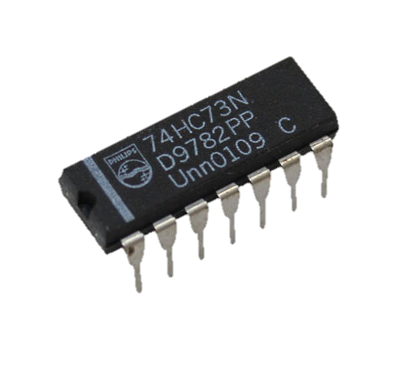


Design Brief
We have implemented a design which includes Asynchronous Mod 5 Up Counter using IC7473 and a BCD to 7 segment decoder and display, to provide a solution to the given problem statement of keeping count of the entrants entering the 4D theatre.
IC 7473

Slide 11
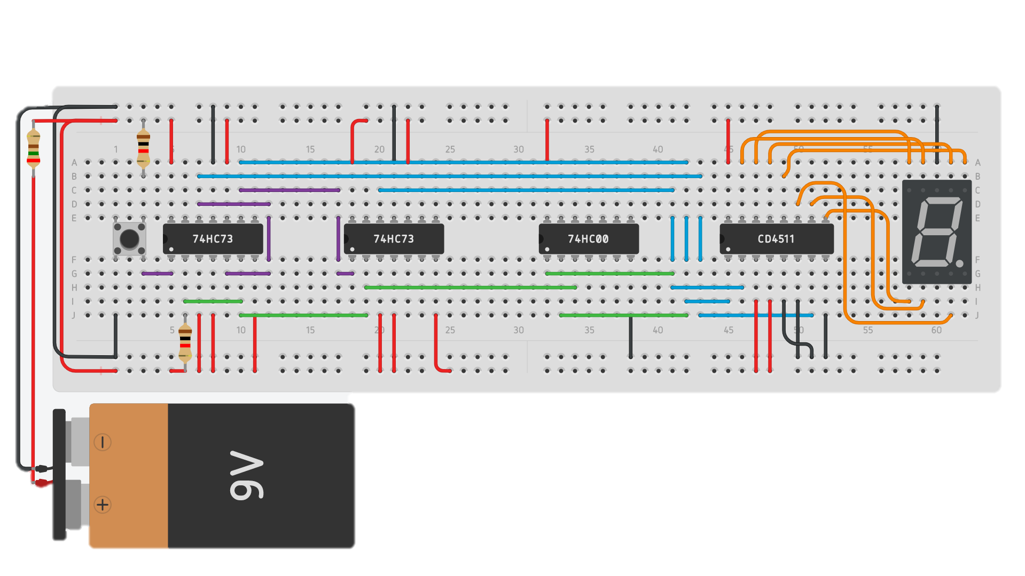
Circuit Implementation on Tinkercad

Slide 12
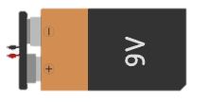

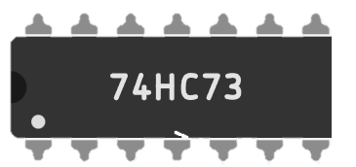
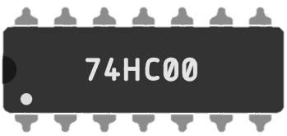
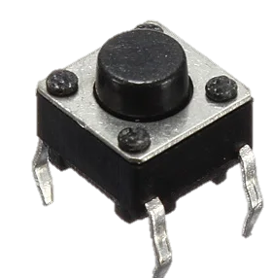
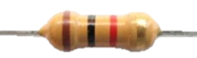

Component List of Circuit
Name | Quantity | Component
BAT 1 | 1 | 9V Battery
Digit 1 | 1 | Cathode 7 Segment Display
U1, U2 | 2 | Dual J-K Flip-Flop
U3 | 1 | Quad NAND gate
U4 | 1 | 7-Segment Decoder
S1 | 1 | Pushbutton
R1, R2 | 2 | 1 kΩ Resistor
R3 | 1 | 250 Ω Resistor

Slide 13
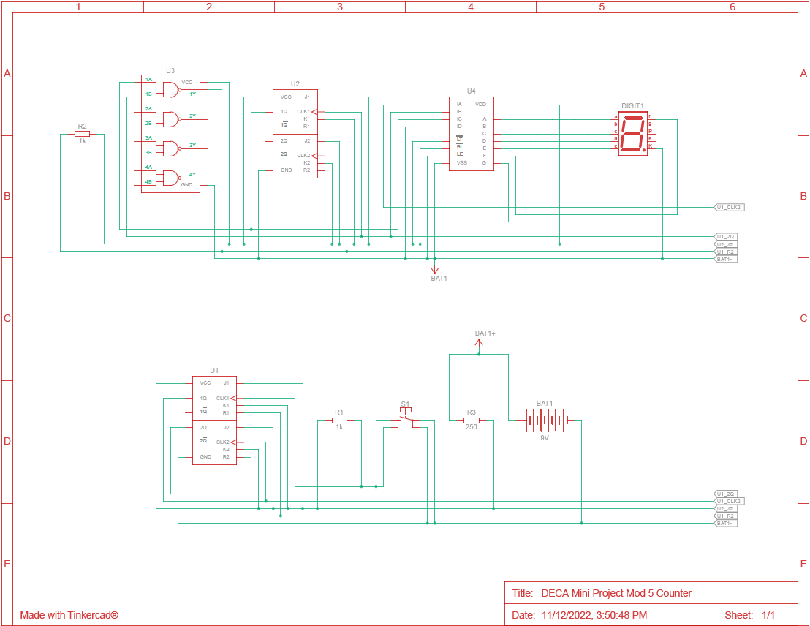
Schematic View

Slide 14
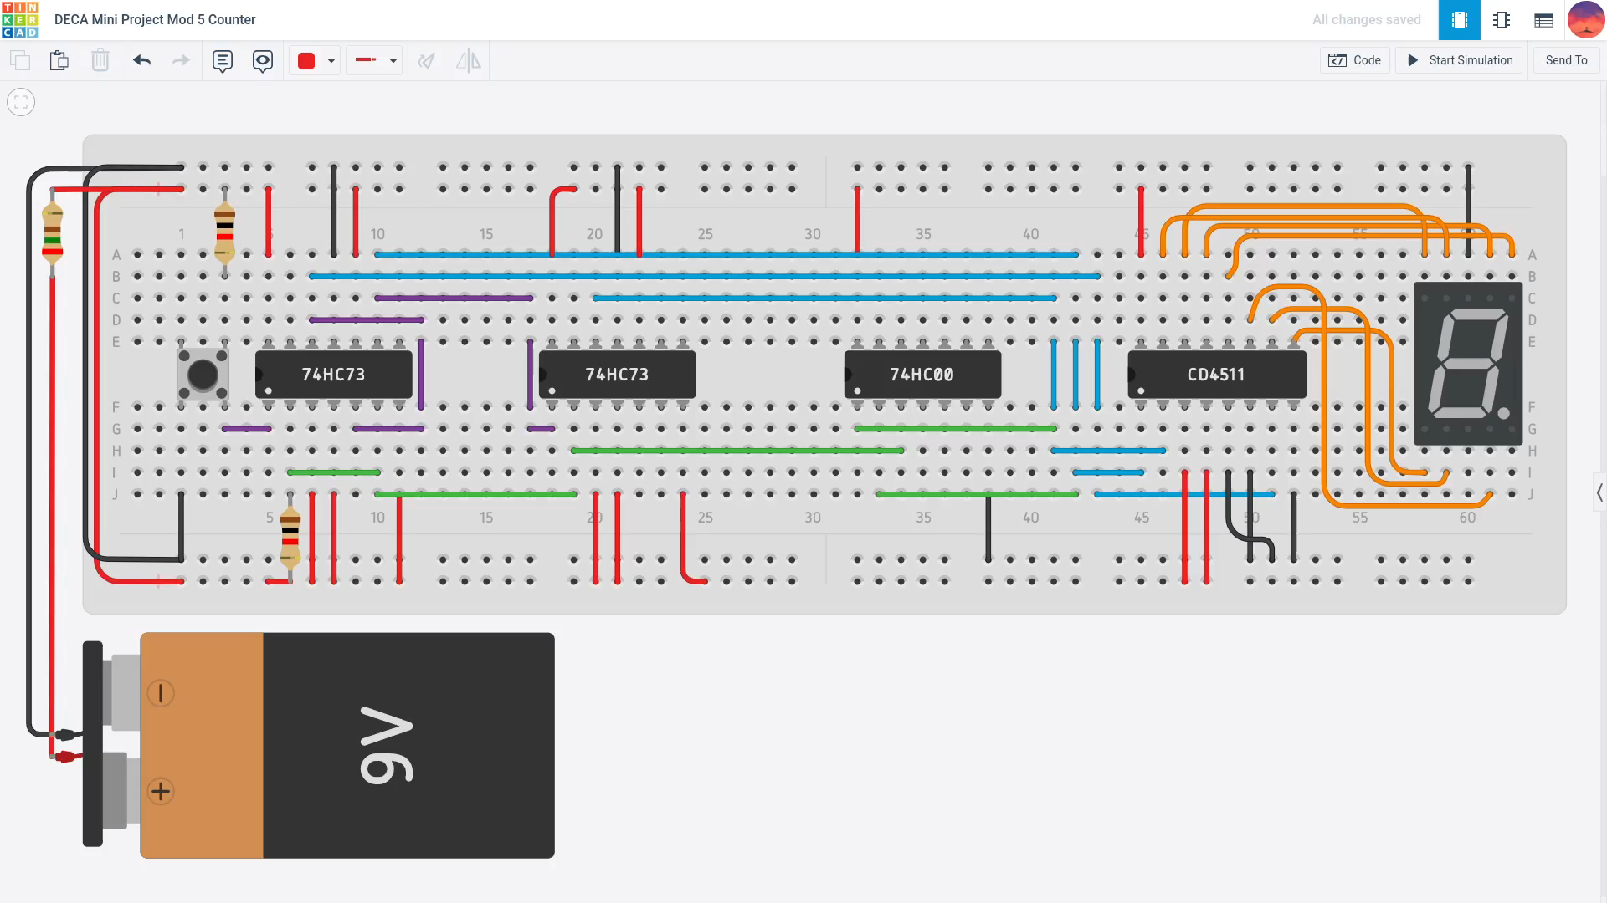
Demonstration of the Circuit

Slide 15
Advantages of Components and Circuit
Shivranjan Pathak

Slide 16
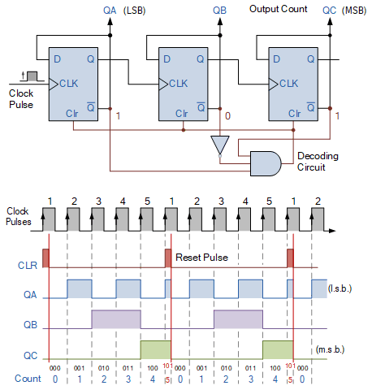
Asynchronous Counters
If the flip-flops do not receive the same clock signal, then that counter is called an Asynchronous counter.
The clock signal is applied only to the first flip-flop. The remaining flip-flops receive the clock signal from the output of its previous stage flip-flop.
As the flip flops are supplied with different clock signals, the output may be delayed.
Another name for Asynchronous counters is “Ripple counters”.
Mod-5 Counter Asynchronous Counter

Slide 17
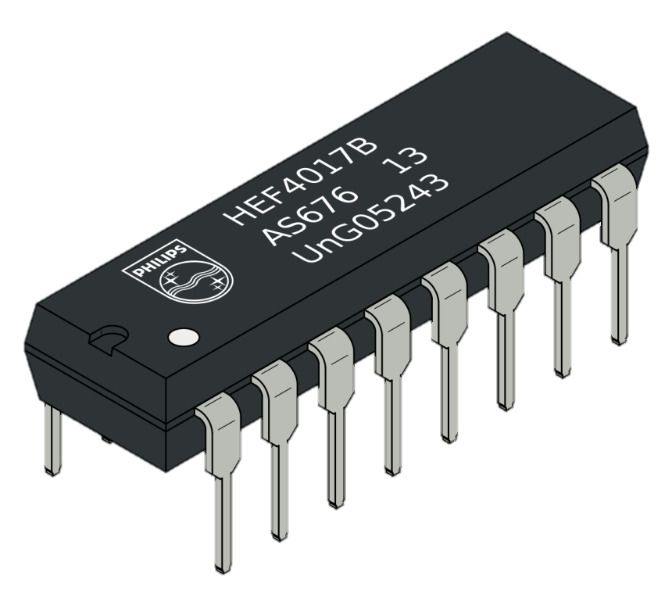
Advantages of using Flip Flops
Flip-Flops have a clock and a toggle input. When a clock is activated, the value of Flip-Flops is inverted.
The main advantage of flip flop is that it has a circuit inside it which contains gates and can generate specific output, it makes a complex circuit much simpler and easier to make and to understand.
It can perform the functions of the set/reset flip flop and has the advantage that there are no ambiguous states.

Slide 18
Advantages of using an Asynchronous Counter
Asynchronous counters can be easily designed by T flip flop or D flip flop.
These are also called as Ripple counters, and are used in low speed circuits.
They are used as Divide by- n counters, which divide the input by n, where n is an integer.
Asynchronous counters are also used as Truncated counters. These can be used to design any mod number counters, i.e. even Mod (ex: mod 4) or like in our case an odd Mod (ex: mod 5)

Slide 19
LIMITATIONS OF COMPONENTS AND CIRCUIT
Vaishnavi Powar

Slide 20
Limitations
If there are multiple doors for the same room, the project becomes quite complex.
If one component in a series circuit fails, then all the components in the circuit fail because the circuit has been broken.
The propagation delay of asynchronous counters is very large, while counting large number of bits. Due to this delay, counting errors may occur for high clock frequencies.
We cannot increment multiple counts of people entering at the same time.

Slide 21
Alternative Solutions to Our Problem
Pratyush Chowdhury

Slide 22
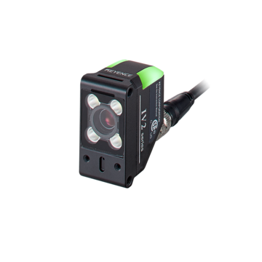
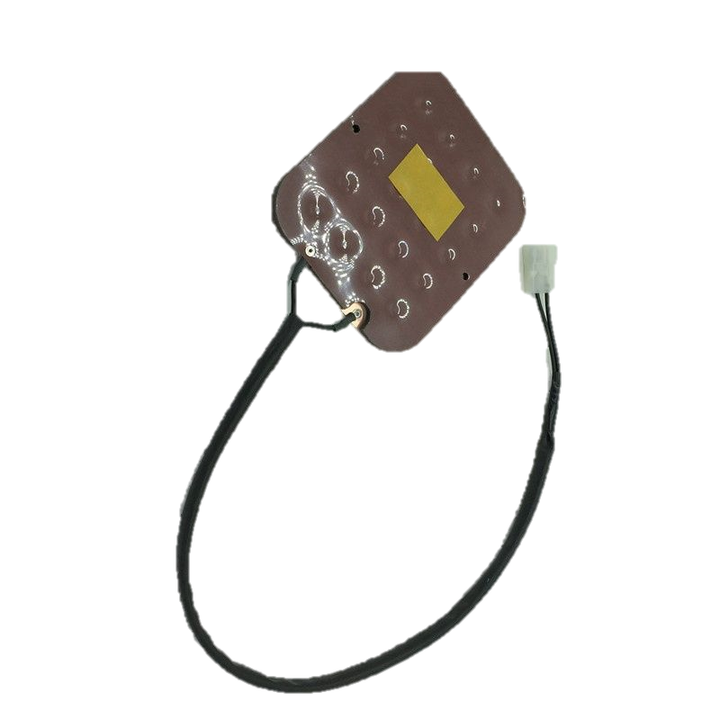
Alternative Solutions
Cameras on the cutting edge have impressive on-board computer vision. They can generate a ton of information about the areas they’re deployed in.
So by installing a smart infrared camera or a thermal camera, we can keep track of people currently inside the theatre. This information can be relayed through a network to a display outside theatre showing the currently occupied seats.
Another Solution is to put sensors below or inside the seat which detect motion and transmit count data to display outside the theatre.
Optical Vision Sensor
Seat Occupancy Sensor

Slide 23
Contribution Details
PA-18 Avipsa Ghorai – Introduction to Flip Flops, Counters & Asynchronous Counters
PA-16 Shivranjan Pathak - Advantages of FFs, Asynchronous Counters
PA-19 Vaishnavi Powar - Limitations of the implemented design
PA-20 Krishnaraj Prashant Thadesar – Tinkercad Circuits, Demonstration of circuit.
PA-17 Pratyush Chowdhury - Other Solutions, conclusion & PowerPoint Presentation

Slide 24
Bibliography
https://www.tinkercad.com/
https://www.electronicshub.org/asynchronous-counter/
https://www.tutorialspoint.com/digital_circuits/digital_circuits_counters.htm#:~:text=Synchronous%20counters-,Asynchronous%20Counters,its%20previous%20stage%20flip%2Dflop
https://www.daenotes.com/electronics/digital-electronics/flip-flops-types-applications-woking
https://www.electronics-tutorials.ws/counter/mod-counters.html

Slide 25
THANKS!
Do you have any questions?

